Slide 1



Biosignals as a game controller
Capstone Project 2023

Slide 2




The Wii console's pioneering motion controllers revolutionized gaming in November 2006.
Modern VR technology offers truly immersive experiences that transport users to virtual worlds.
Can we find a revolutionary way to
interact with computers?

Slide 3
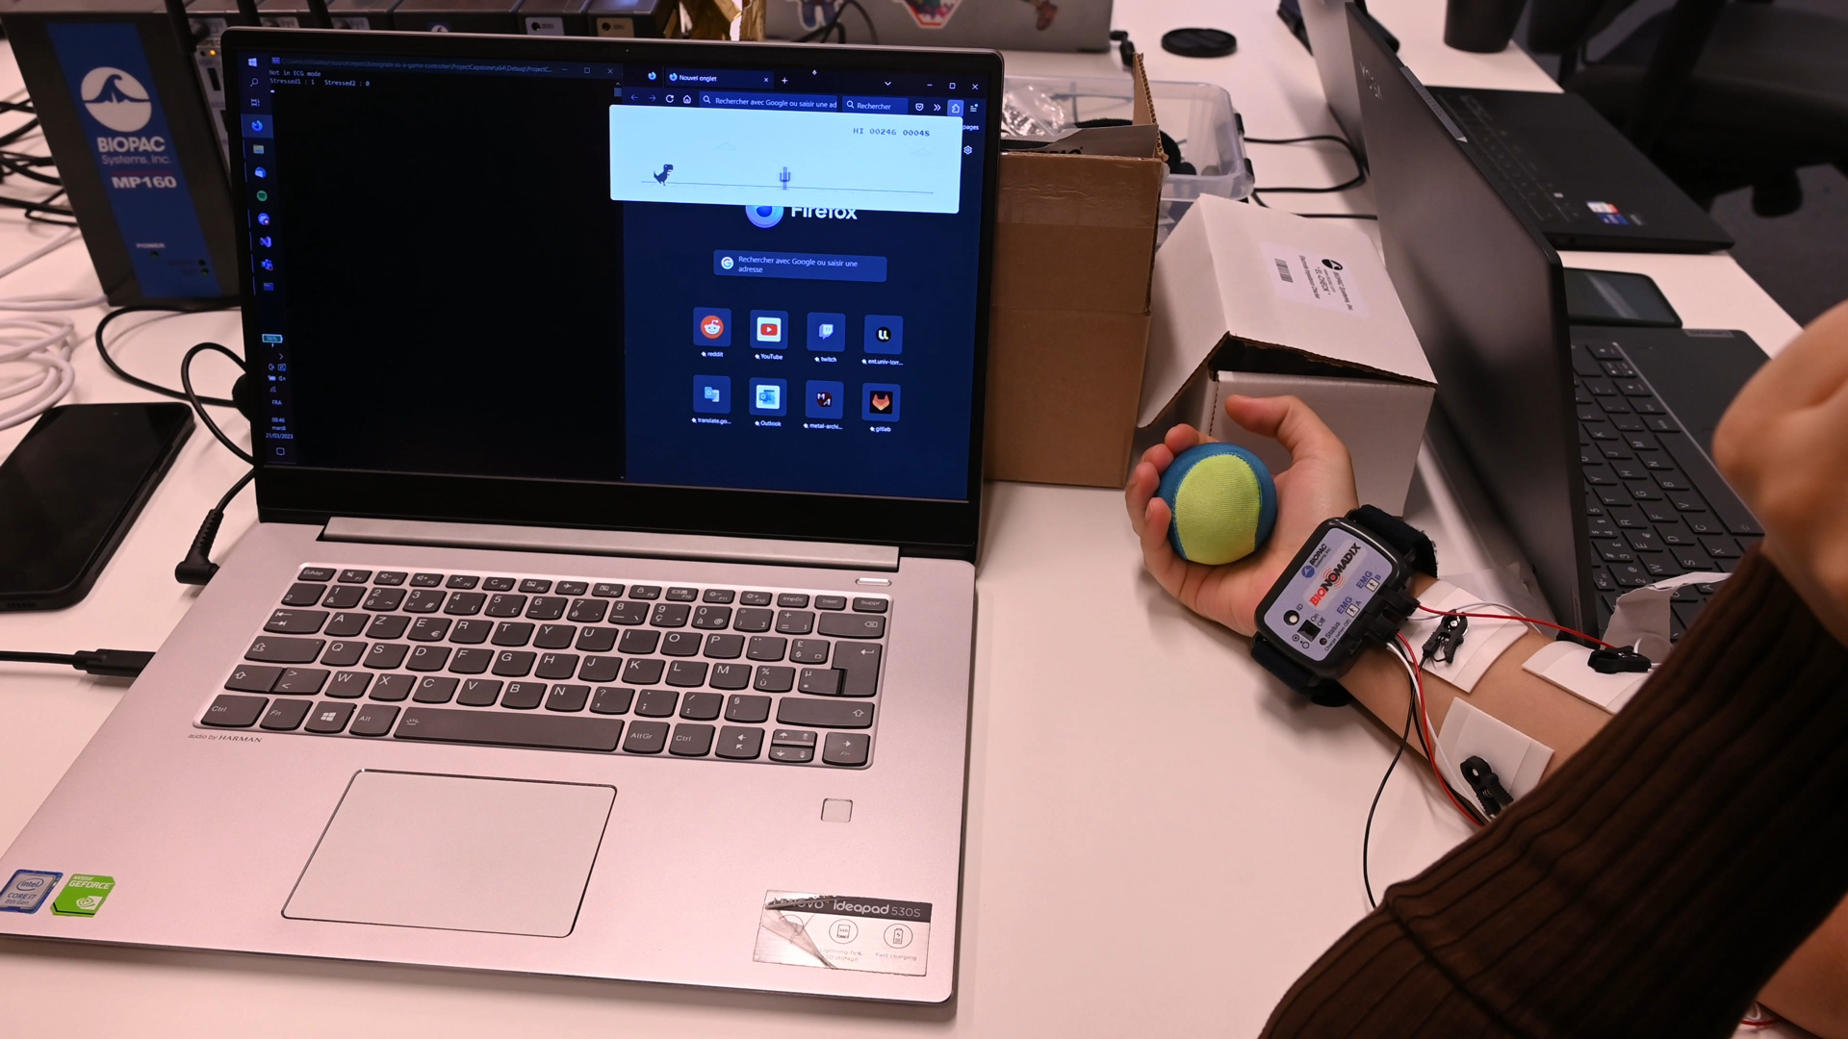

GAMING WITH EMG AND ECG
EMG Demonstration : we can control the game by flexing the muscles

Slide 4


A NEW WAY TO INTERACT WITH COMPUTERS!
+ Accessibility
Elderly
Individuals with disabilities
Notes:
other photos of people with disabilities

Slide 5
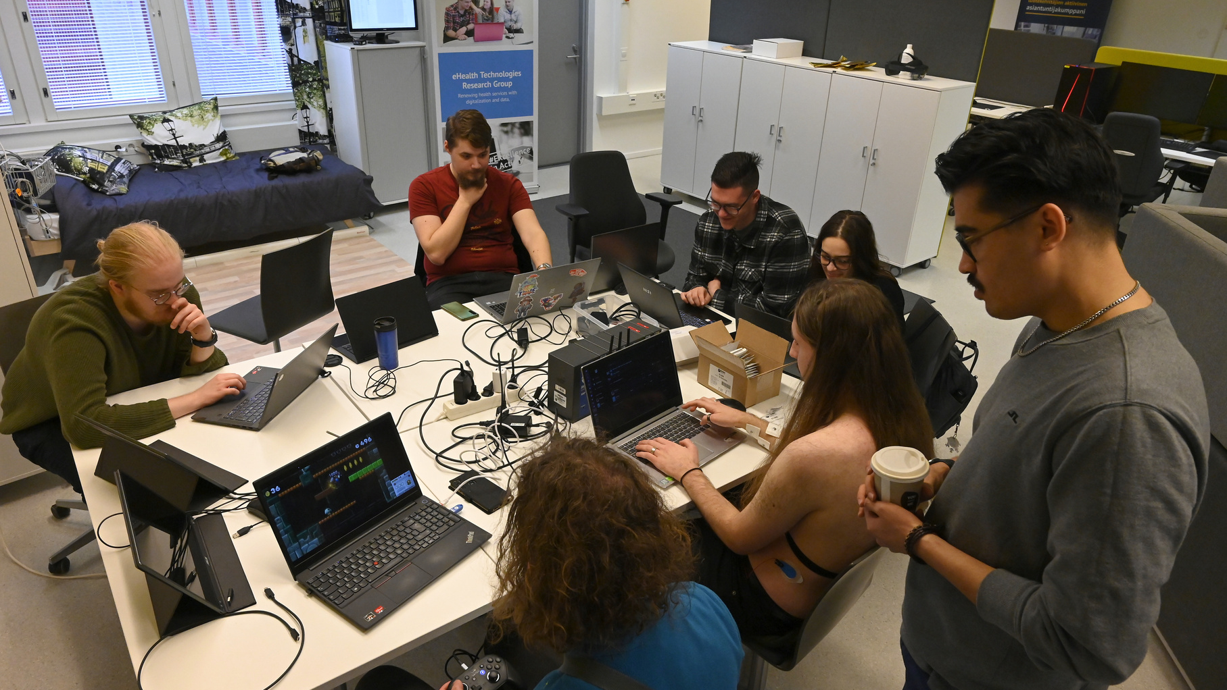
Going Forward...
Now in R&D phase
Promissing research
Portable and affordable

Slide 6
QUESTIONS
Biosignals as a game controller - Capstone 2023

Slide 7






Q A
&
Which companies could potentially be interested in investing with our product ?
gaming companies / controller companies
What is the sales strategy ?
1 time purchase with purchasable "expansion packs"
Are there any competitors in the industry?
No, for now it's academical research only
What is the estimated development timeline until the final product ?
~ 5 years
What are some of the major technical challenges ?
ECG signal filtering

